Slide 1

Advanced course
Lesson 33
DIY coures（11）
Color sorter
YahBoom Croco:Kit tutorial

Slide 2
Advanced course
Content
Part1
Part 2
Part3
Part 4
Part 5
Learning goals
Preparation
Connection
Search for blocks
Combine blocks
YahBoom Croco:Kit tutorial

Slide 3
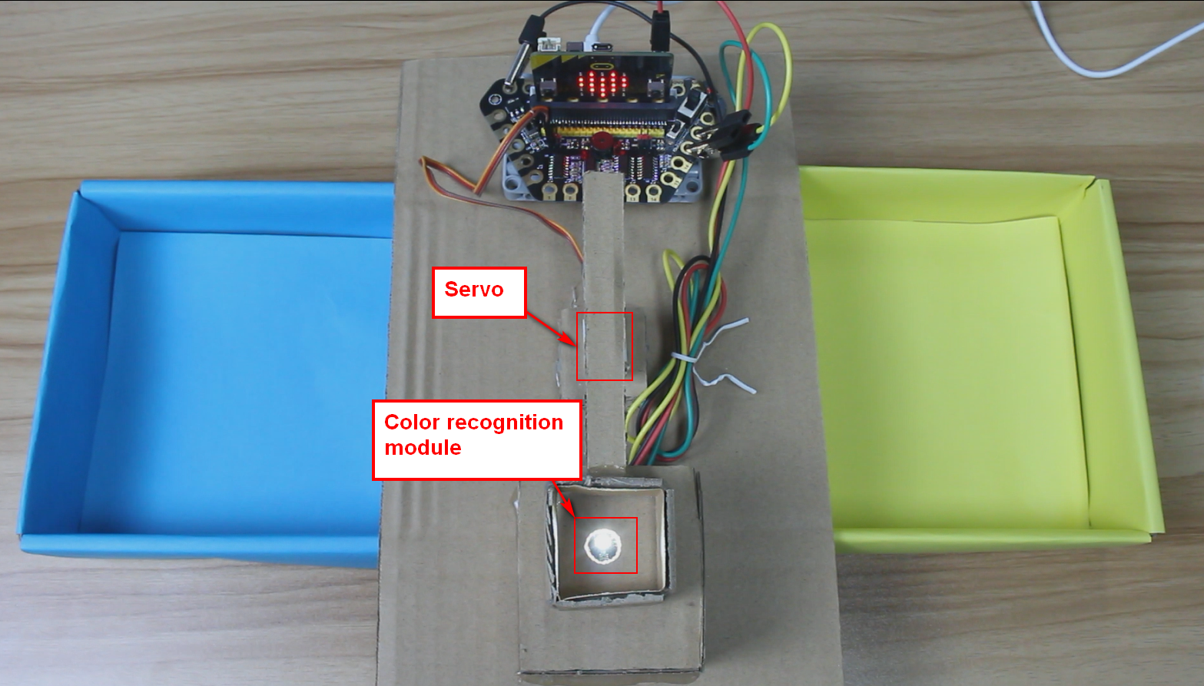
Advanced course
Part 1
Learning goals
After downloading the program, we can see that the micro:bit LED dot matrix shows a “heart”, initialize the servo 90°.
When we put blue or yellow things on the color sensor, the servo will turns different angles, classify some different colors products.
YahBoom Croco:Kit tutorial

Slide 4
Advanced course
Part 2
Hardware:
● 1 X Micro:bit Board
● 1 X Micro USB Cable
● 1 X Diamond breakout
● 4 X Alligator clip
● 1 X Servo
● 1 X Color recognition module
● 1 X PC
Preparation
Mode 1 online programming: First, we need to connect the micro:bit to the computer by USB cable. The computer will pop up a USB flash drive and click on the URL in the USB flash drive: http://microbit.org/ to enter the programming interface. Add the Yahboom package: https://github.com/lzty634158/Croco-Kit to program.
Mode 2 offline programming: We need to open the offline programming software. After the installation is complete, enter the programming interface, click【New Project】, add Yahboom package: https://github.com/lzty634158/Croco-Kit , you can program.
YahBoom Croco:Kit tutorial

Slide 5
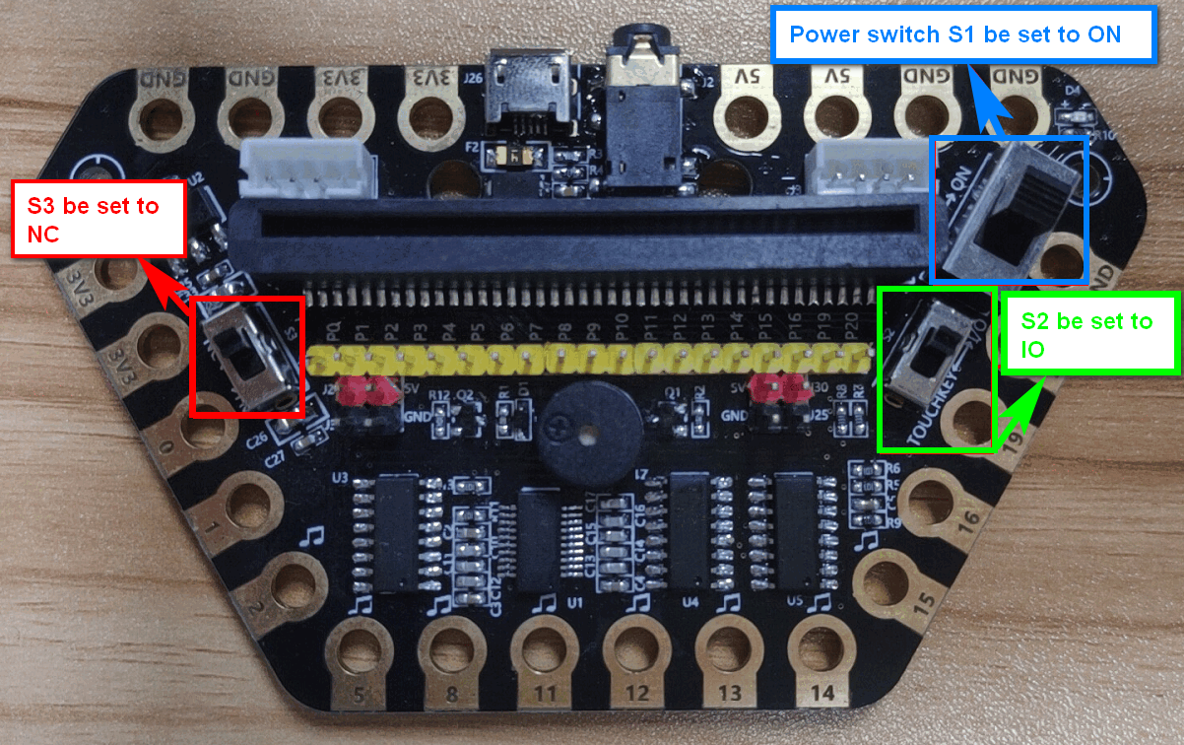
Advanced course
Part 2
Preparation
! ! !Note: S1 be set to the ON, S2 be set to the IO, and S3 to the NC.
YahBoom Croco:Kit tutorial

Slide 6
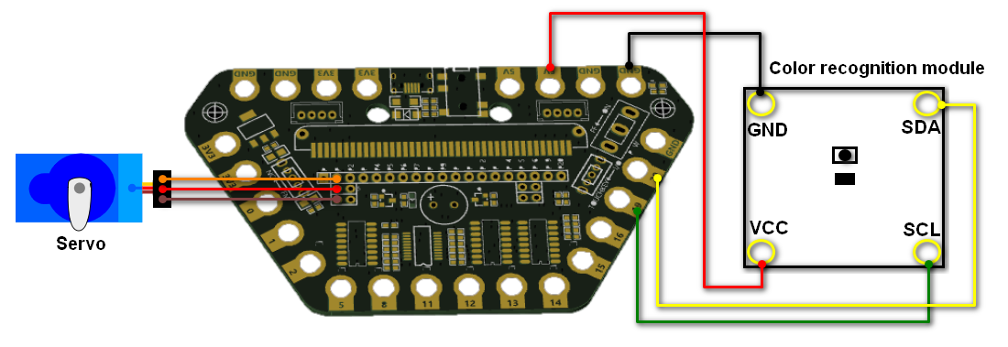
Advanced course
Part 3
Expansion board | Color recognition module | Servo
P1 |  | Orange line
P19 | SCL
P20 | SDA
5V | VCC | Red line
GND | GND | GND
Connection
YahBoom Croco:Kit tutorial

Slide 7
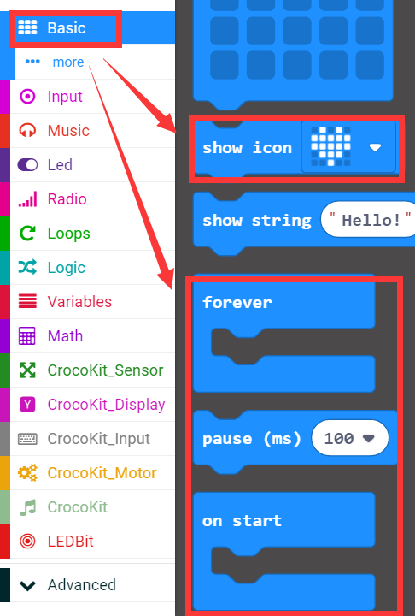
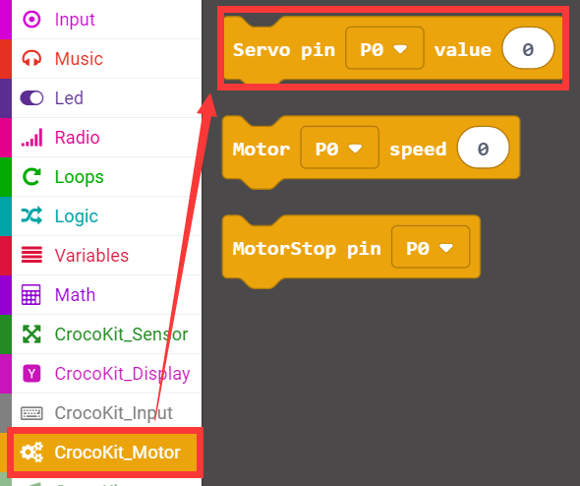
Advanced course
Part 4
Search for blocks
YahBoom Croco:Kit tutorial

Slide 8
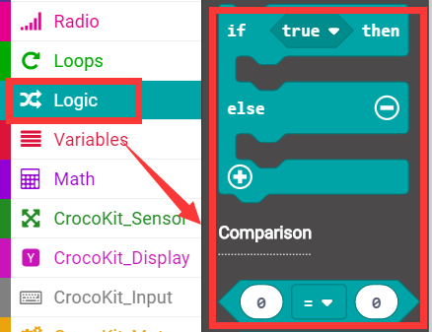
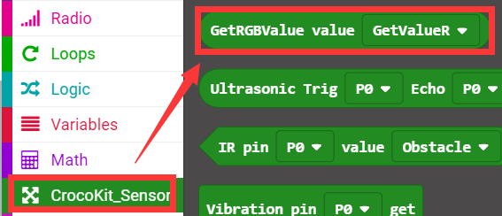
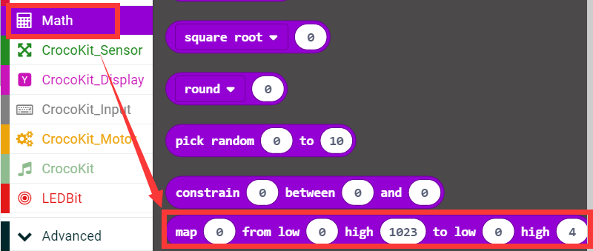
Advanced course
Part 4
Search for blocks
YahBoom Croco:Kit tutorial

Slide 9
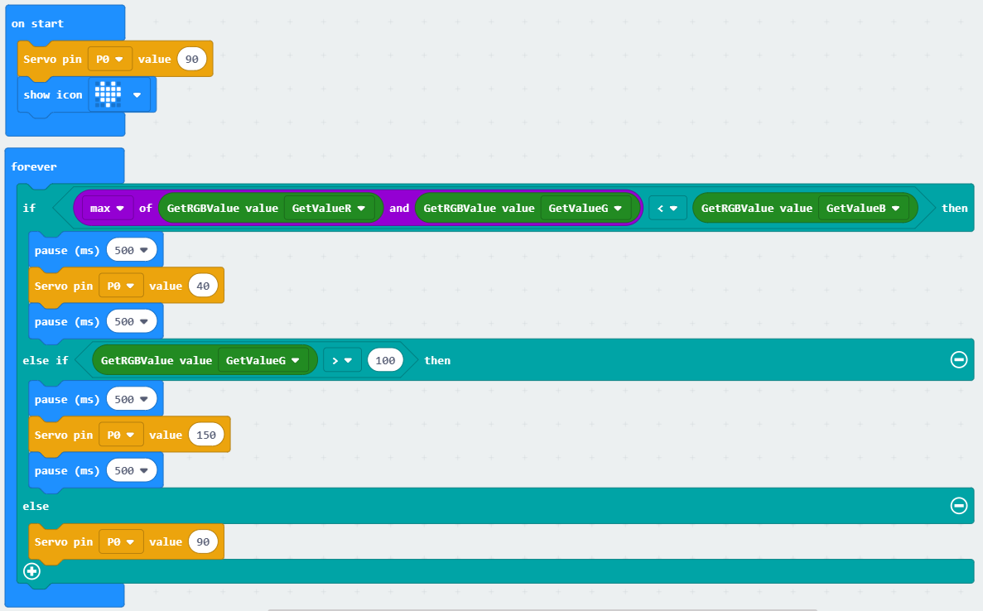
Advanced course
Part 5
Combine blocks
YahBoom Croco:Kit tutorial

Slide 10
Advanced course
Thank you ！
Powered by YahBoom
YahBoom Croco:Kit tutorial

